Slide 1
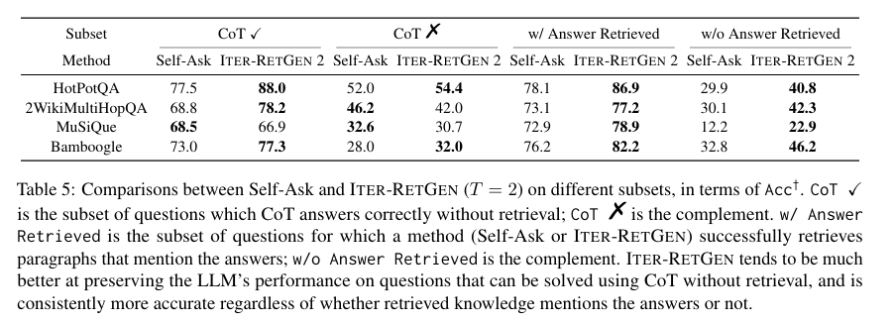
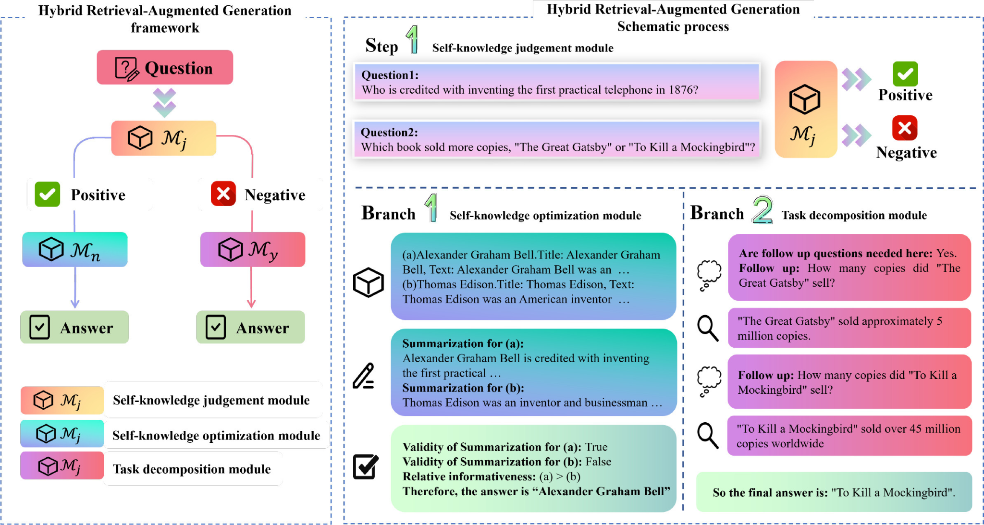
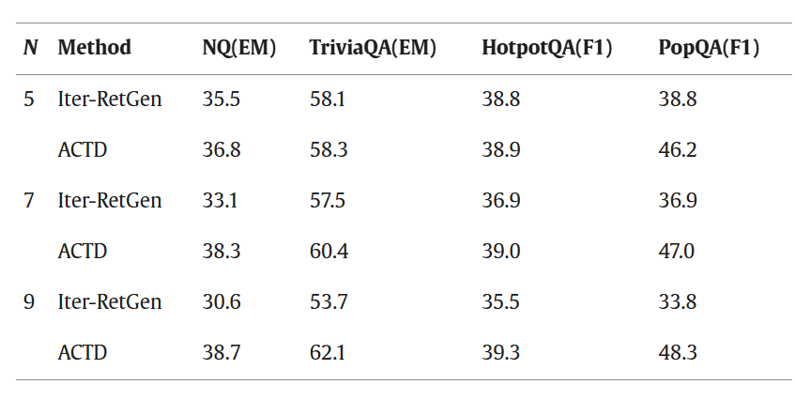
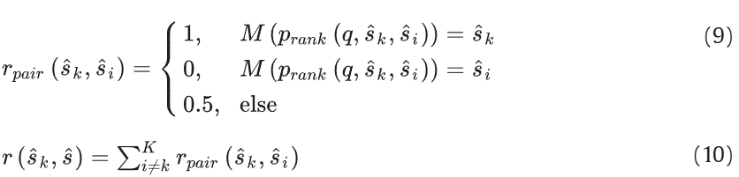
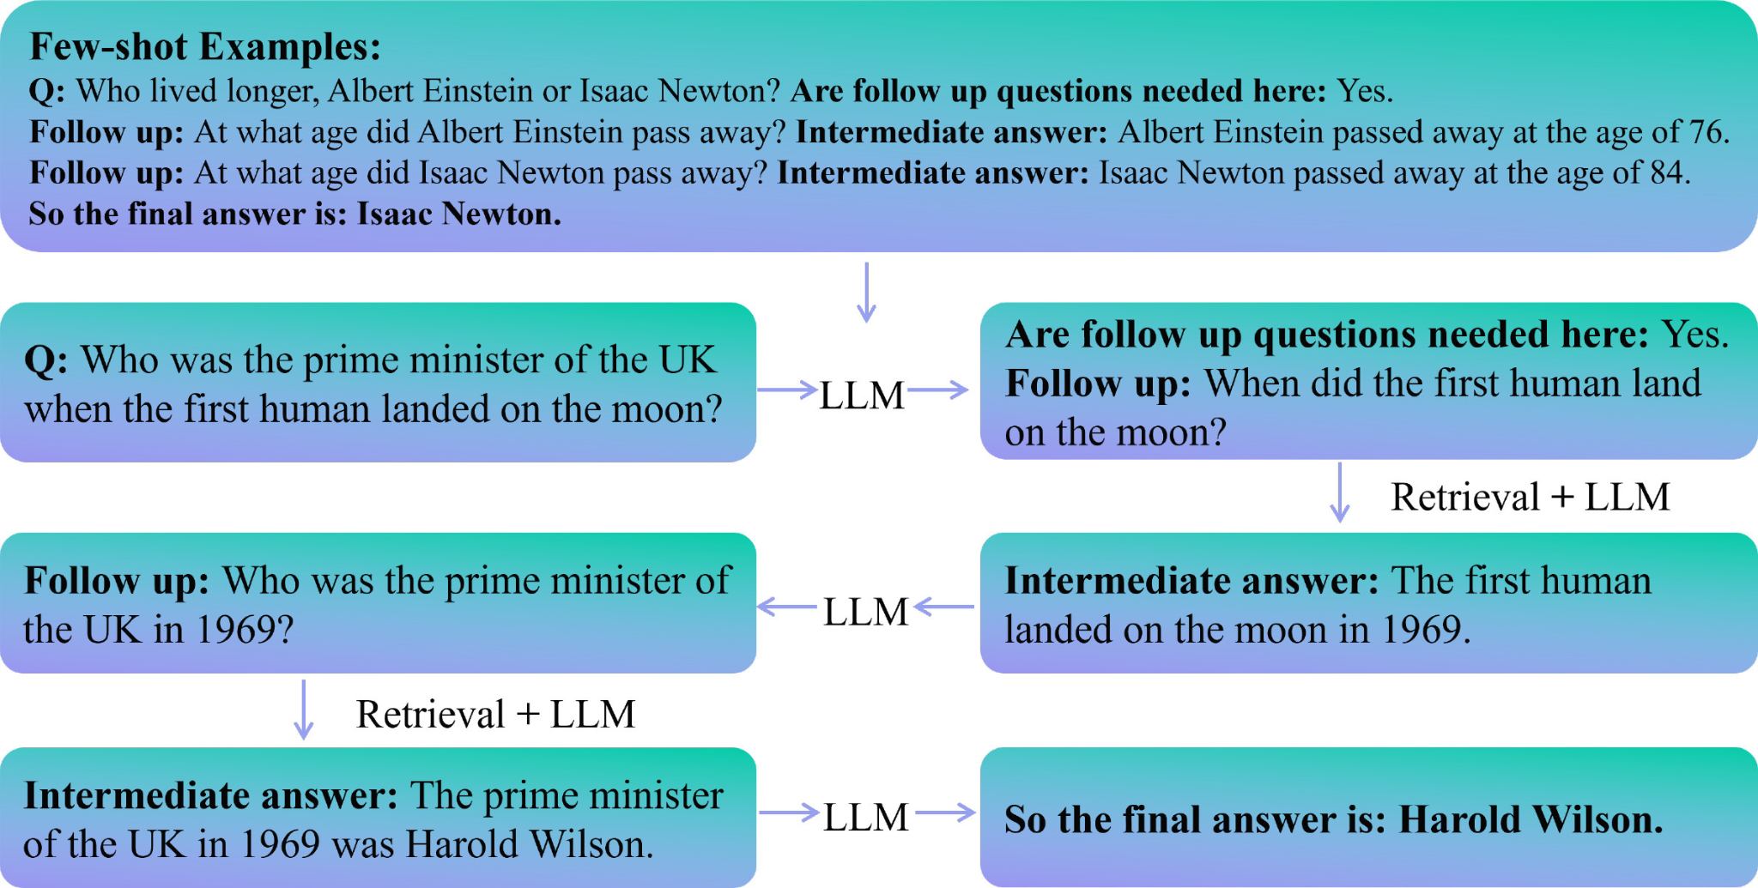
Artificial Intelligence - Fine Tuning and RAG
Your Full Name and My Full Name (54)
Ramu Battu and Nitaigour P Mahalik
Department of Industrial Technology, Jordan College of Agricultural Science and Technology, California State University, Fresno, California, USA
Abstract
METHODOLOGY
RESULTS
This poster focuses on the application of retrieval-augmented generation (RAG) and fine-tuning to large language models (LLMs) of artificial intelligence to increase accuracy and decrease hallucination anomaly for better model credibility. The use of iterative methods allows for LLMs to pull information from an already-existing knowledge base and check the information generated with external sources, but without a way to determine whether or not the information is "correct" often leads to repeated information or irrelevant knowledge generated alongside a response. To refine and enhance the process, task decomposition with answer candidates (ACTD) is applied, with each additional iteration helping to refine the retrieval of more (if necessary) information.
If the question is shown as q, the LLM will repeat retrieval generation for a given T iterations and prompt an output with both the retrieved paragraphs (D) and the question (q) in the answer. By using the retrieved paragraphs in tandem with the initial generated response, the LLM is meant to produce an optimized response so that more necessary information can be retrieved. Different LLM models was prompted with a question and its response predicted alongside, to compare the generated answer. Additional iterations are added to determine if the answer will become more comprehensive and applicable with every iteration; however, the LLM will not summarize previous documents to reduce summarization errors.
Additionally, a hybrid approach using the LLM to check whether or not existing information is acceptable before applying RAG allows for energy conservation and enhancement of already-existing memory and knowledge with RAG.
After asking four different LLM models, this shows the accuracy percentage after one iteration under ‘Self-Ask’ and after two iterations under ‘Iter-RetGen’; in almost every case, it can be shown that Iter-RetGen outperforms Self-Ask. The CoT portion determines which questions are answered correctly without additional retrieval; it can also be shown that in cases with retrieval, answer accuracy increases by a large margin and is consistently more accurate even if there is no answer retrieved (in some cases, even without an answer the accuracy of using retrieval is about the same). However, when involving ACTD next to Iter-RetGen, it can be said that ACTD performs at or above Iter-RetGen using the same LLM models, proving that breakdown of questions leads to more accurate answers.
INTRODUCTION AND BACKGROUND
AI is unable to accurately process data for answer generation, leading to incorrect but plausible responses being generated, known as hallucination anomaly, coming from the LLM prioritizing fast response time over accuracy in response generation. This ultimately discredits LLMs overall and in some cases can even lead to major decision-making errors (1); because of this, it is necessary to implement RAG over multiple iterations (2) to improve response accuracy by checking generated information with external sources and validating the information internally. RAG integration done correctly can also improve overall consistency, structure, and performance of LLMs (3).
LITERATURE REVIEW
DESIGNS
Prior research done on the application and implementation of RAG (retrieval-augmented generation) and fine-tuning of AI include potential methods of RAG utilization to mitigate hallucination anomaly (Lv et al., 2026) to create a better and higher-performing AI overall, testing different modules and their performance output (Shao et al., 2023) from various prompts. Both found that RAG module implementation increased the effectivenes of the AI when answering more complex prompts (Shao et al., 2023), with an improved fine-tuning method known as ACTD (answer candidates and task decomposition) to determine whether or not the AI can generate a correct response using its own knowledge base - if the AI is unable to do so, it will then proceed to task decomposition to locate more specific answer candidates before generation. By evaluating whether or not RAG is necessary, this reduces hallucination anomaly and ensures continued model credibility (Lv et al., 2026).
Unfortunately, despite attempts to reduce AI-hallucination anomalies using RAG and AI fine-tuning, AI is limited by cost and model stability, making it more difficult for machine learning to be actively utilized in real-time (Gao et al., 2026). Even with two iterations and RAG utilization, 10% of incorrectly generated answers come from incorrect interpretation of correctly sourced information (Shao et al., 2023).
Answer quality is evaluated using validity and compared to other generated answers to determine which is best - that is, the answer that is not only correct but supported by relevant explanations using a point system. The answer with the highest point ranking becomes integrated into the final answer, or is the final answer in the case of only one question. However, for appropriate accuracy, it is necessary to break down even single-sentence questions to properly retrieve the correct information.
DISCUSSION AND CONCLUSIONS
In summary, these experiments allow for researchers to determine how best to improve response accuracy and reduce LLM hallucination by reviewing different LLMs under different methods (no retrieval, one iteration - Iter-RetGen, and multiple iterations - ACDT). It was determined that the best method involved the most iterations, but this also has a detrimental affect on the LLM's memory storage as the LLM is focused on breaking down and compartmentalizing the questions and subquestions for the most accurate answer. The robustness and capacity of LLMs can be improved by using RAG and ACTD desspite the inefficiency of response generation at the current moment; additionally, improvements are being developed to increase response generation speed and LLM processing to create a reliable and quick question-answering system by reducing hallucination anomalies.
REFERENCES
Gao, Qianfa, et al. “Multitask Fine-Tuning Agentic AI Based Collaborative Scheduling for Flexible Manufacturing Systems.” Journal of Manufacturing Systems, vol. 86, June 2026, pp. 864–886, https://doi.org/10.1016/j.jmsy.2026.04.022. Accessed 17 Apr. 2026.
Lv, Jinxin, et al. “Dual-Strategy Retrieval-Augmented Generation for Anomaly Recovery in Large Language Models.” Pattern Recognition, vol. 178, Oct. 2026, p. 113430, https://doi.org/10.1016/j.patcog.2026.113430. Accessed 16 Apr. 2026.
Shao, Zhihong, et al. Enhancing Retrieval-Augmented Large Language Models with Iterative Retrieval-Generation Synergy. 2023.
Notes:
1

